Slide 1

PUBLIC KEY
INFRASTRUCTURE
BY-
SOHAM NAG
(INTERN TECH I)
KEYSIGHT TECHNOLOGIES..

Slide 2

Let’s dive in!!!

Slide 3
CONTENTS:
ENCRYPTION AND ITS NEED
SYMMETRIC AND ASYMMETRIC ENCRYPTION
NEED FOR PKI ?
HASHING
PUBLIC KEY INFRASTRUCTURE
PKI COMPONENTS
X.509 CERTIFICATE STANDARD
CERTIFICATE AUTHORITY
VALIDATION , REVOCATION AND AUTHENTICATION
FUTURE PROSPECT
CONCLUSION
SOURCE CODES

Slide 4
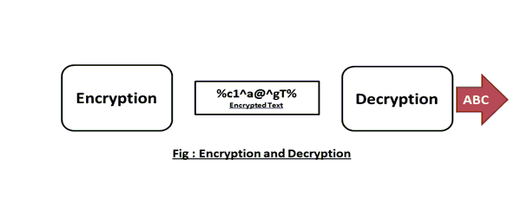
ENCRYPTION AND ITS NEED:
•Encryption is encoding messages or information with a key in such a way that only authorized parties can decrypt it.
•Used to protect the data in transit ,thereby prevents data theft/spoofing hence ensures confidentiality.

Slide 5
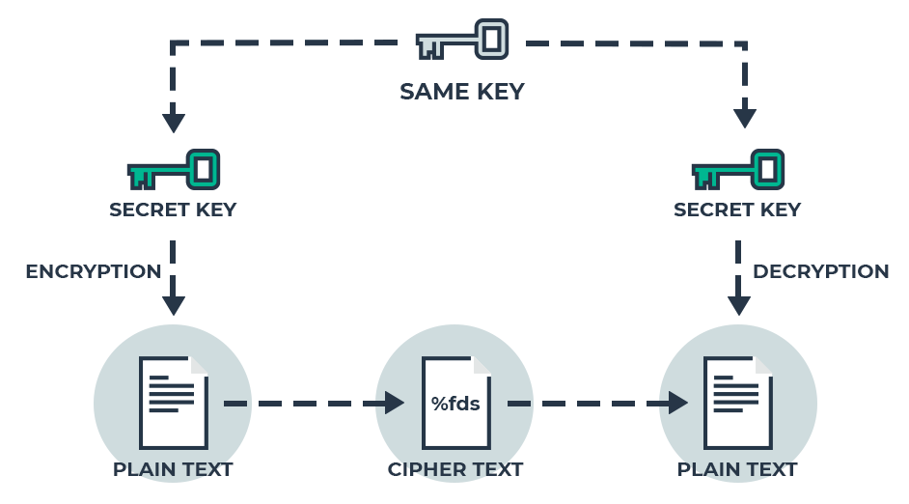
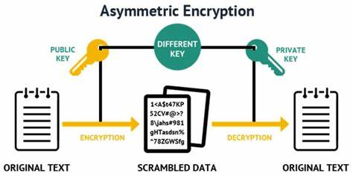
SYMMETRIC AND ASYMMETRIC ENCRYPTION :
SYMMETRIC ENCRYPTION ASYMMETRIC ENCRYPTION
In symmetric encryption scheme , the same key In asymmetric encryption scheme, we use
(secret key) is used to both encrypt and decrypt public key to encrypt the data and private
the text. Key to decrypt the data.

Slide 6
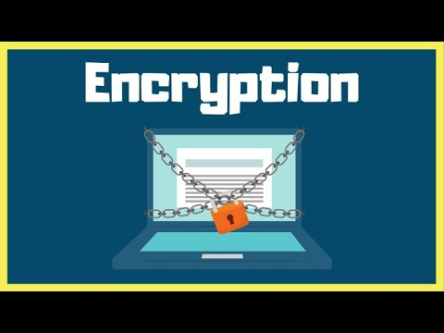
The following video link from youtube has been provided for more insights.
CLICK ON THE IMAGE TO PLAY THE VIDEO

Slide 7
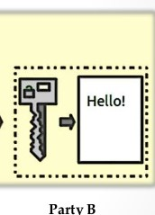
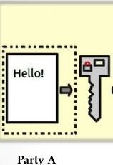

NEED FOR PKI?
In asymmetric encryption, the public key of a device has to be known by all other devices (made public). But how can we distribute the public keys safely to our devices? we have to ensure that the public keys that are exchanged over the network are authentic, and hence authenticity must be ensured for that key exchange.

Slide 8
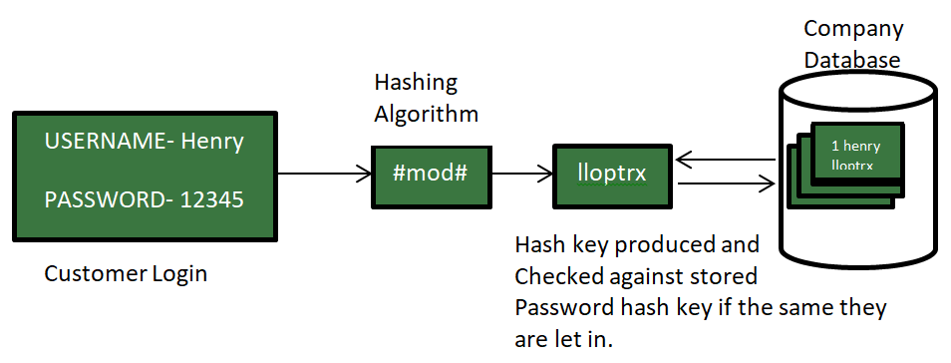
HASHING:
In hashing data is converted into hash using some hash function which can be any number generated from string or text. Hash codes are of fixed length and unique. It can also be used for password verification. Examples: MD5,SHA1 etc.
MORE ON HASHING

Slide 9
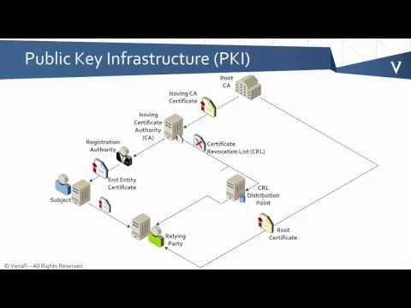
PUBLIC KEY INFRASTRUCTURE:
➤A public key infrastructure (PKI) is a system for the creation, storage, and distribution of digital certificates which are used to verify that a particular public key belongs to a certain entity.
➤The PKI creates digital certificates which map public keys to entities, securely stores these certificates in a central repository and revokes them if needed.
CHECK ME OUT FOR MORE!!

Slide 10
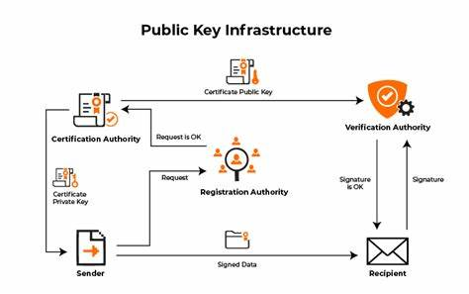

Slide 11
PKI COMPONENTS:
issues certificates of ownership of a public key by named entity
database of active digital
certificates for a CA .
CERTIFICATION AUTHORITY
REPOSITORY
REGISTRATION AUTHORITY
CERTIFICATE
trusted by a CA to register or vouch for users of the CA
includes public key, information about the identity of the party .

Slide 12
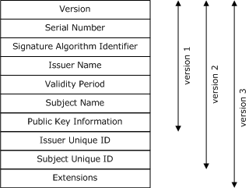
X.509 CERTIFICATE:

Slide 13
CERTIFICATION AUTHORITY:
➤A CA issues and verifies certificates .
➤The CA takes responsibility for identifying (to a stated extent) the correctness of the identity of the person asking for a certificate to be issued, and ensures that the information contained within the certificate is correct and digitally signs it

Slide 14
VALIDATION , REVOCATION & AUTHENTICATION:
REVOCATION
AUTHENTICATION
VALIDATION
➤This is the process that ensures that the certificate information is still valid and can be changed.
➤This is the process of informing the users that the certificate information is invalid.
➤In order for the subject to access gain to its private key it has to possess an encrypted file or something else like PIN/ fingerprint.

Slide 15
FUTURE PROSPECT OF PKI:
➤PKI in IOT.
➤PKI in enterprise units.
➤PkI in blockchain technology.
➤PKI in 5g & cloud.
In conclusion, a full fledged development in this sector might take the world of cyber-security to its next level.

Slide 16
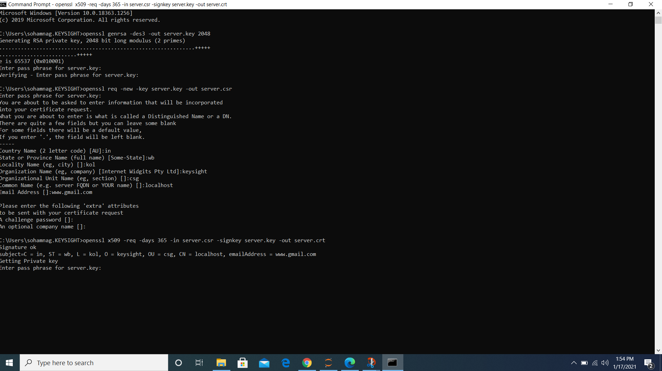
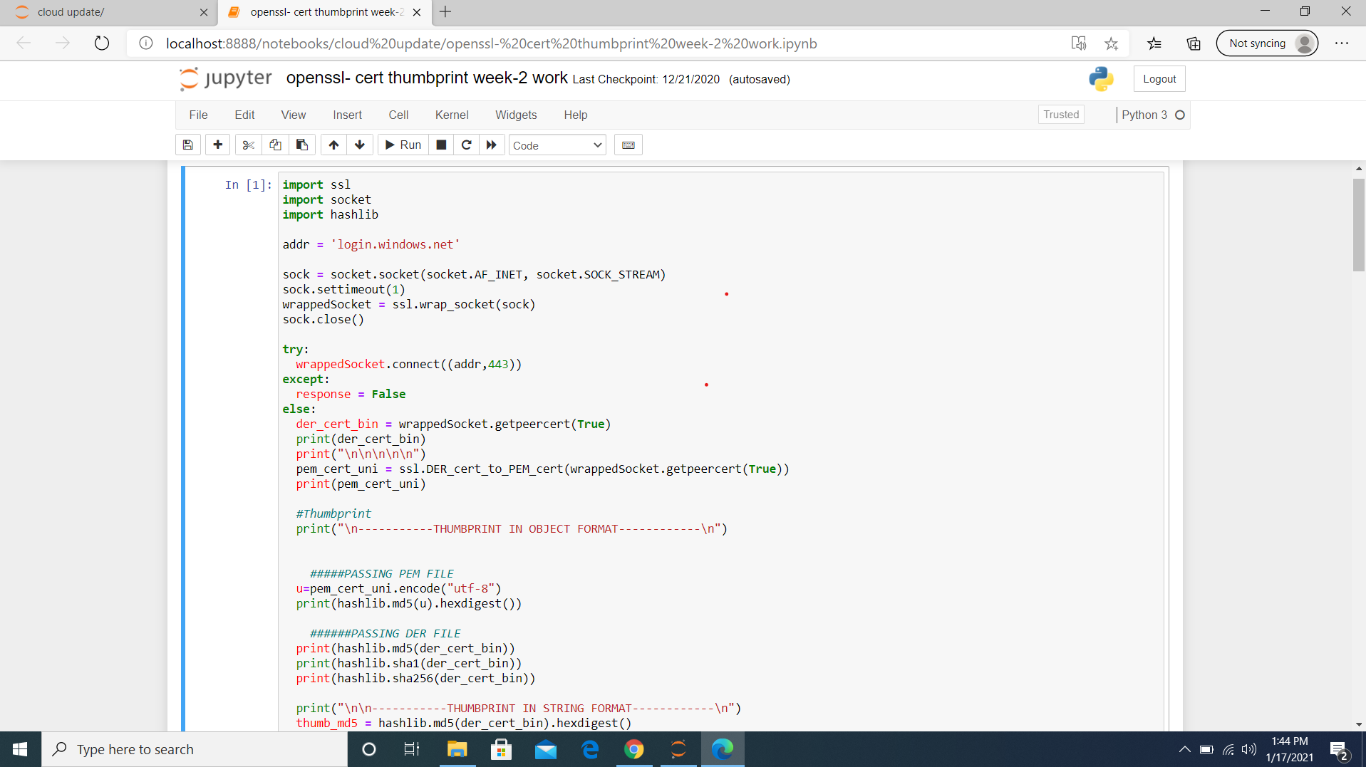
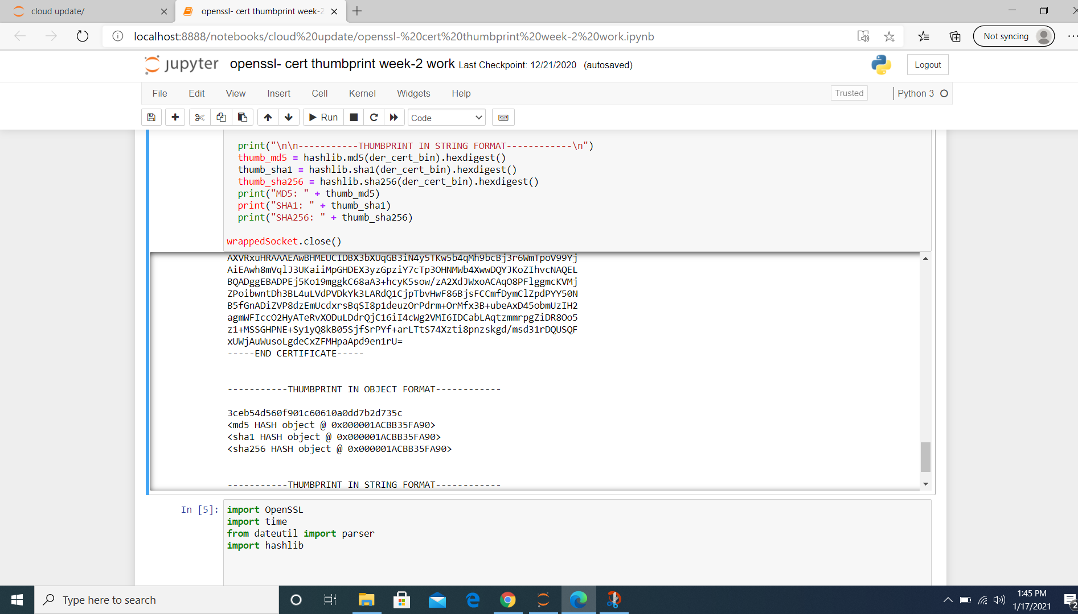
SOURCE CODES:

Slide 17
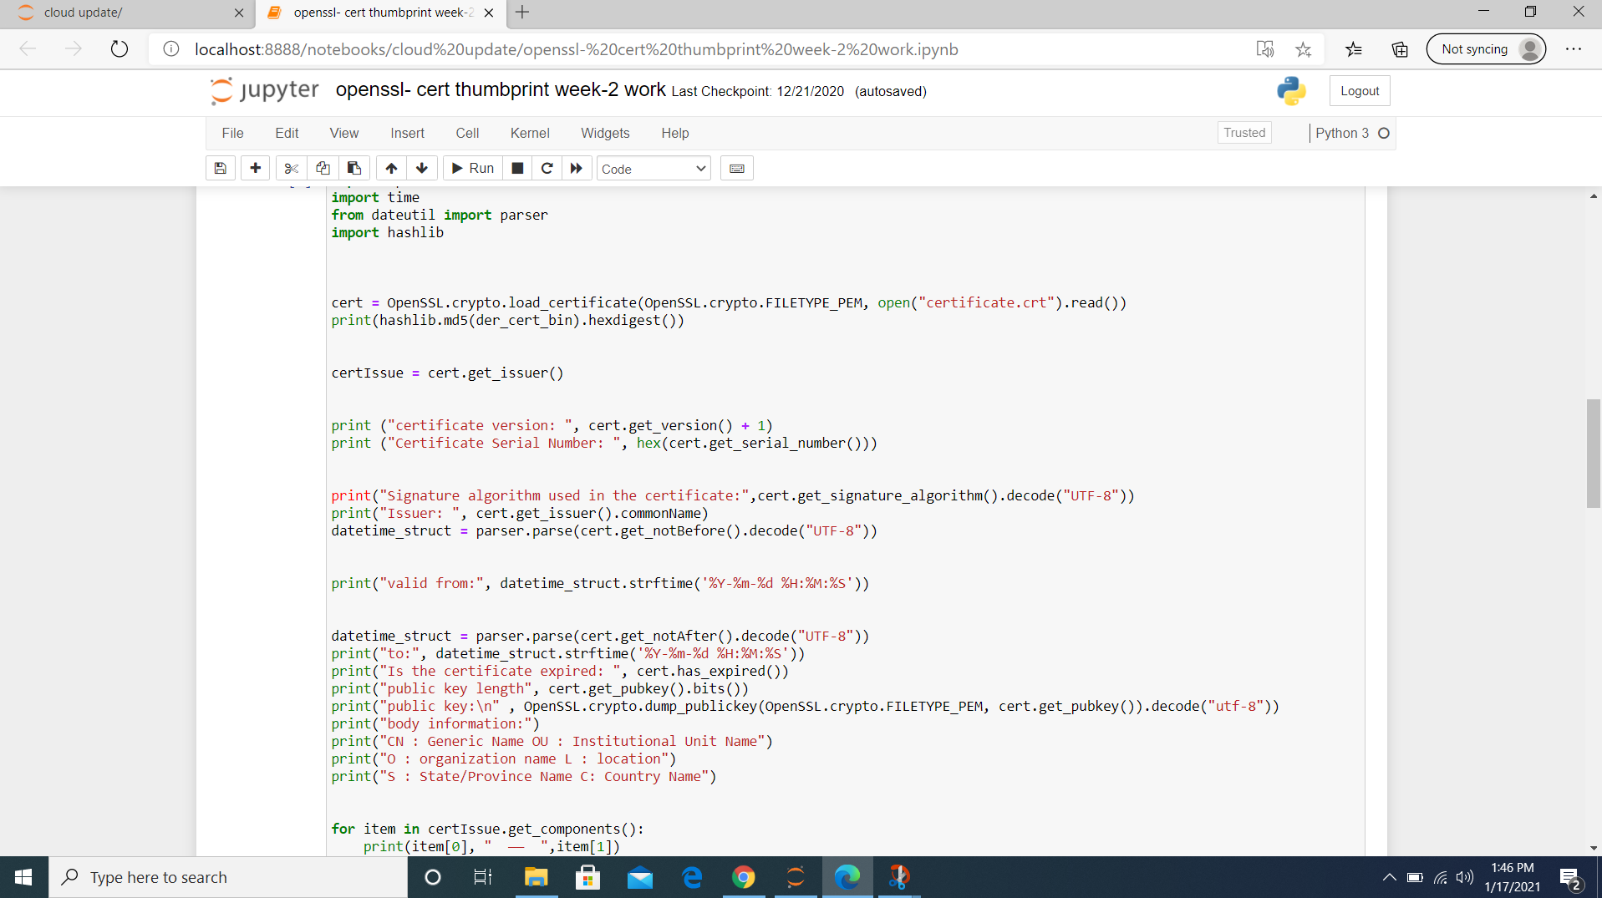
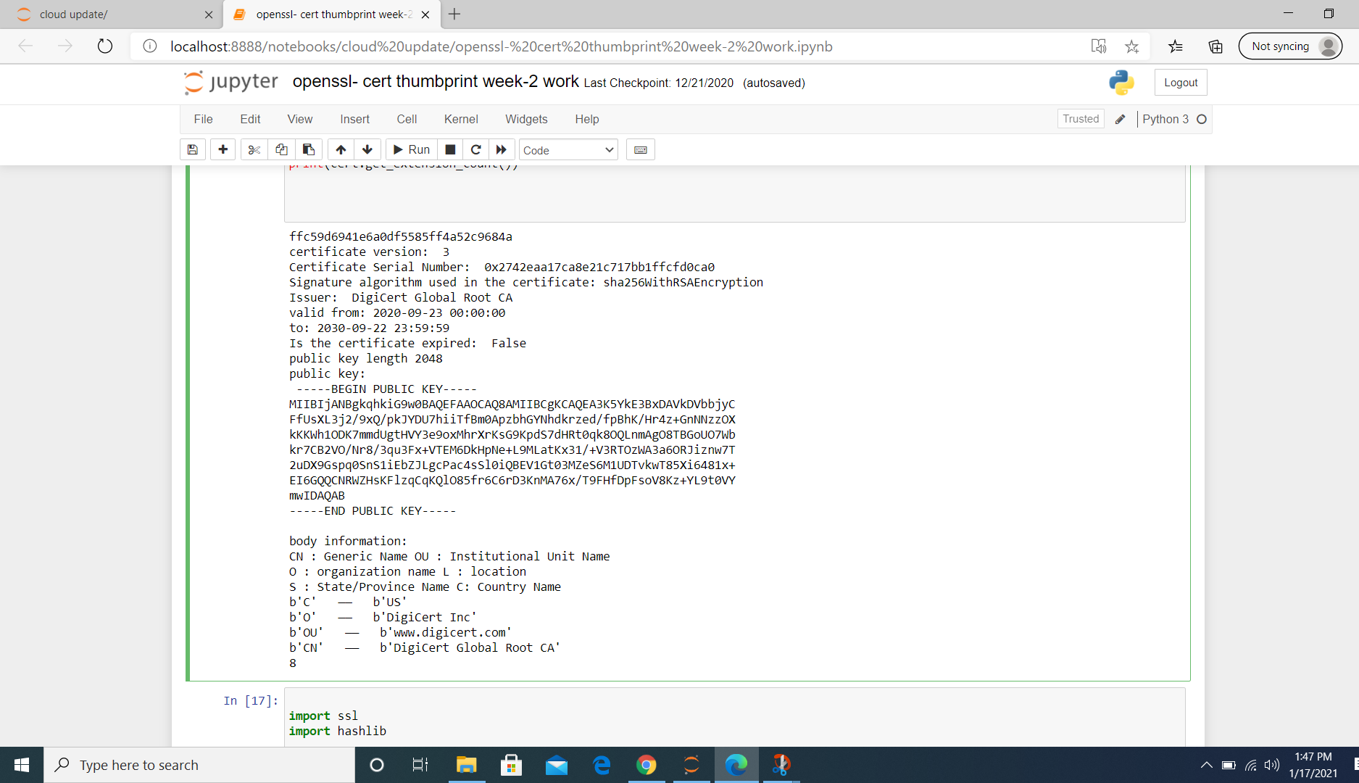
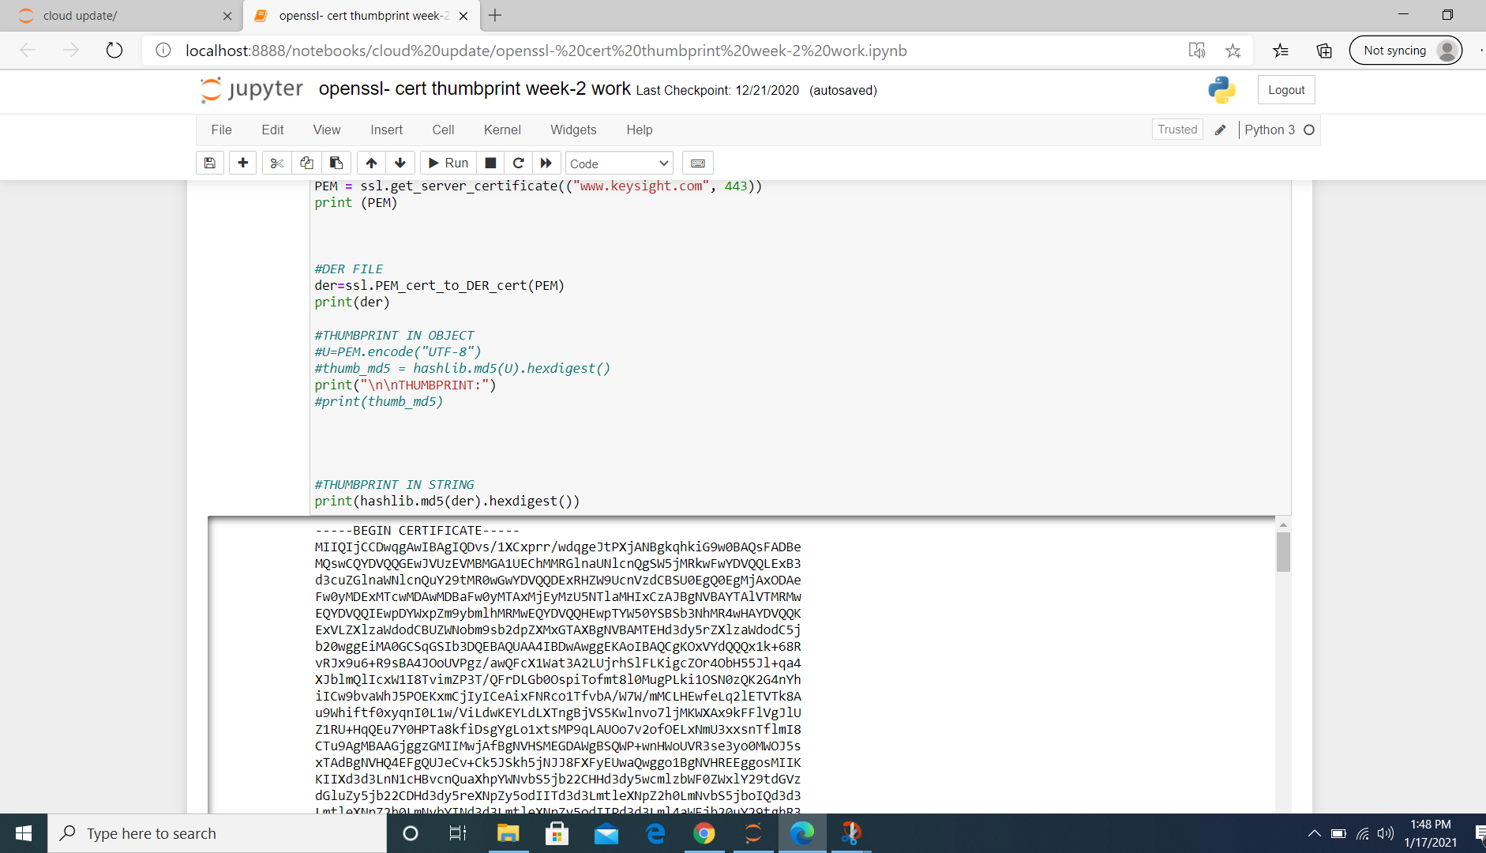

Slide 18

CONCLUSION:
➤Fully PKI enabled asymmetric cryptosystems have great practical implications in the outsourcing of illegal data breaching.
➤RFC 2822 (Internet Security Glossary) defines PKI as a set of hardware,software,people,policies and procedures to revoke digital certificates based on asymmetric cryptosystems

Slide 19

REFERENCES:
[1]. https://en.wikipedia.org/wiki/Encryption
[2]. http://gauss.ececs.uc.edu/Courses/c653/lectures/PDF/pki.pdf
[3]. https://aboutssl.org/certificate-authority
[4]. https://flylib.com/books/en/2.110.1/the_need_for_a_pki.html
[5].https://docs.microsoft.com/en-us/dotnet/api/system.servicemodel.security.x509clientcertificateauthentication.revocationmode?view=netframework-4.8
[6].
https://www.youngwonks.com/blog/Public-Key-and-Private-Key-Encryption-Explained

Slide 20


Slide 21


Slide 22


